Slide 1


Fundamentals of RM
RM System and Process
Leadership in RM
Incident Investigation
RM Tools & Challenges
RM in Industry
People & Org.
Application and Perspectives
On Becoming a
Leader in Risk Management
ENGG404 - Lecture
Chapter 4.2: Cause and Effect Model for Incident Analysis
Chapter 4.3: Root Cause Analysis of an Incident
- Fundamentals -

Slide 2
Learning Outcomes:
This topic explains the purpose and application of the Cause & Effect Model, and the fundamental constructs of a Root Cause Analysis.
Analyze an incident sequentially and explain the nature of the different types of causes, and their sub-categories.
Apply the Discovery Model to start the RCA Chart.
Logically link the causal factors in incident investigations.
Interpret and apply a Cause and Effect Model for analyzing incidents.
Interpret, apply, and construct a Root Cause Analysis of a loss incident.
Differentiate between immediate, intermediate, basic, and latent causes.
Chapter 4.2: C&E Model & Chapter 4.3: RCA of an Incident
‹#›
Notes:
‹#›

Slide 3
Introduction:
Chapters 4.2 and 4.3 teach you how to analyse a loss incident!
Two complementary tools for Incident Investigation:
Cause and Effect Model
Root Cause Analysis Work Process
These will allow you to:
Find all potential cause-effect relationships in a logical manner.
Classify causes by their type such that they can be better understood and recommendations are optimized.
Link incident causes with failures in the RMS.
The RCA WP is applied to analyse a loss incident and create an RCA Chart.
C&E Model is used to check the thoroughness of the RCA Chart.
Chapter 4.2: C&E Model & Chapter 4.3: RCA of an Incident
‹#›
Notes:
‹#›

Slide 4
Important To Keep In Mind:
Learning how to do an RCA is easy!
Learning how to do an RCA well is a struggle!
  Easy to confuse causes, effects, and consequences.
  Easy to jump to conclusions ...
The approach taken here is to build your competency in layers.
First, the facts and sequence of events [timeline] are needed!
(incident investigation work process)
Second, apply the RCA work process to create the RCA Chart.
Third, apply the Cause and Effect Model to check the RCA Chart.
Chapter 4.2: C&E Model & Chapter 4.3: RCA of an Incident
‹#›
Notes:
‹#›

Slide 5
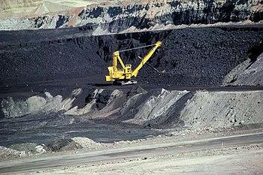
ALE Lead-in: Losses and Causes
Put yourself into the role of the supervisor in this real loss incident:
You are called to a scene where a mining haul truck and a shovel have been crushed with debris from an adjacent slope. You find one individual with a severe injury. You know the slopes are being monitored, you know there are procedures for safe work near the slopes, and you know it has been raining for the last week.
This “Mine Loss LI” will be
used during this lecture to
develop your skills in the
RCA work process.
Using your best engineering
know-how and deduction skills,
please confer and answer the
following questions:
Chapter 4.2: C&E Model & Chapter 4.3: RCA of an Incident
‹#›
Notes:
‹#›
The aim of this exercise is to pick on their answers in Mentimeter and discuss some of them in terms of “jumping to conclusions”, “facts”, “logic leaps”, etc.
Another aim is to demonstrate that the causation of a loss incident can be explained in rational, sequentially logical terms.

Slide 6
The Cause and Effect Model:
Unstructured exercise:
The previous exercise was meant to be “unstructured”.
There were many causes, so which one is the correct response?
How can all these causes be logically organized?
In order to logically analyse an incident, one needs to apply the different categories of causes.
The Cause and Effect Model can be used to:
Categorize and summarize the facts of a loss incident.
Communicate the nature of an incident and its causes.
Helps you discern the various different categories of causes, and thus aid in the development of the root cause analysis of a loss incident.
Check the thoroughness of the incident investigation and the root cause analysis.
Note: There are many different C&E Models practiced in industry. This is one of many.
Chapter 4.2: C&E Model & Chapter 4.3: RCA of an Incident
‹#›
Notes:
‹#›

Slide 7
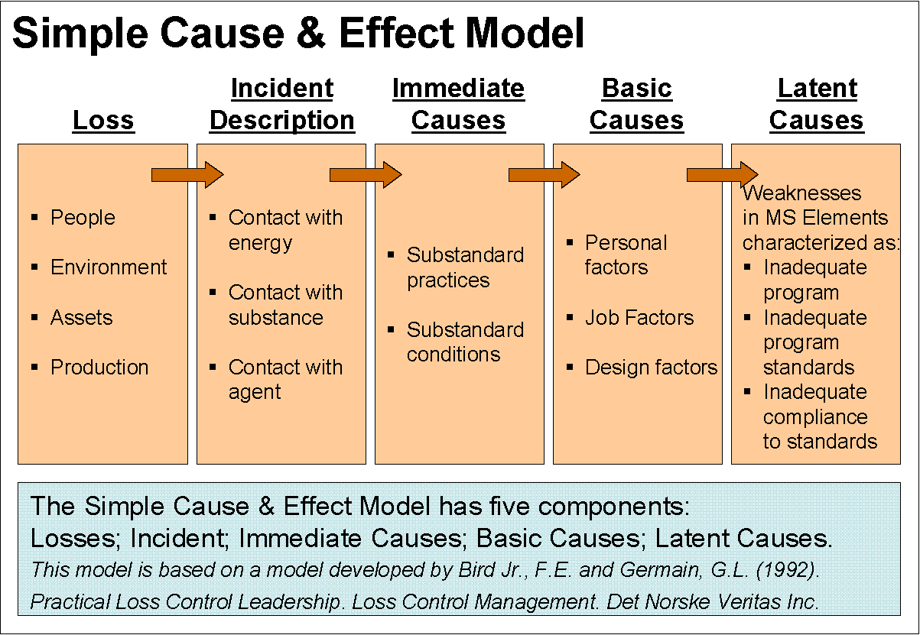
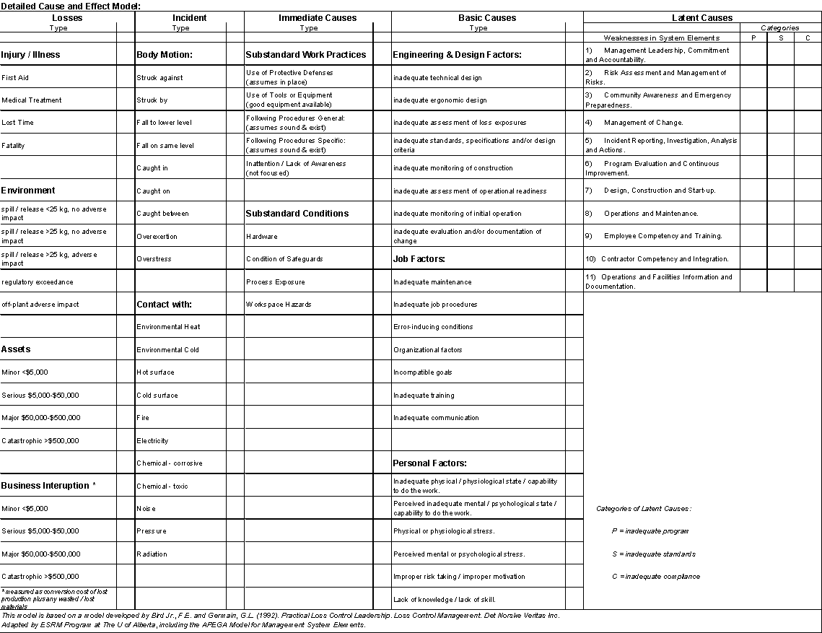
The Cause and Effect Model:
Overview
Details
The Five Components of a Cause and Effect Model:
Losses (PEAP)
Incident Description
Immediate Causes in two categories:
  Substandard practices and sub-groups
  Substandard conditions and sub-groups
Basic Causes in three categories:
  Engineering & Design Factors
  Job Factors and sub-groups
  Personal Factors and sub-groups
Latent Causes
Chapter 4.2: C&E Model & Chapter 4.3: RCA of an Incident
‹#›
Notes:
‹#›

Slide 8
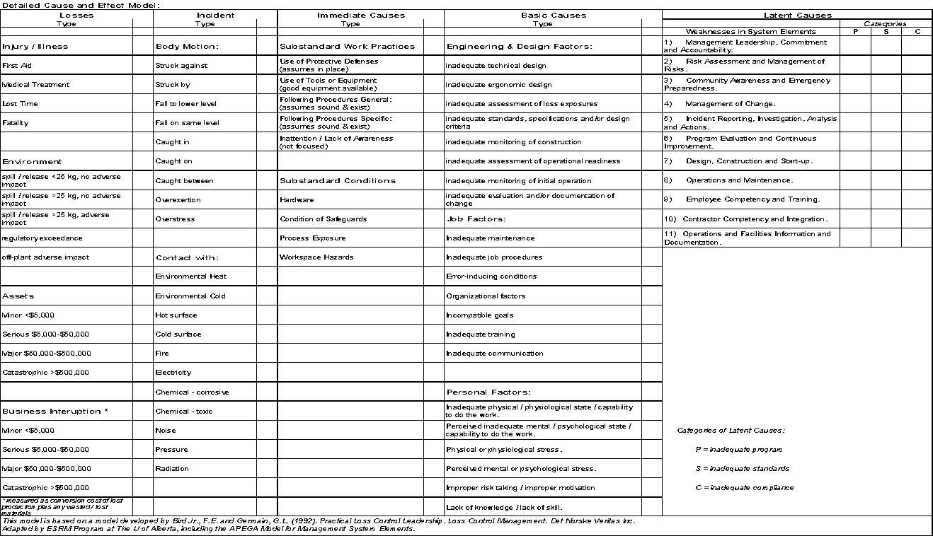
The Cause and Effect Model:
Left side:
Chapter 4.2: C&E Model & Chapter 4.3: RCA of an Incident
‹#›
Notes:
‹#›
C&E helps you be more specific in terms of losses and causes

Slide 9
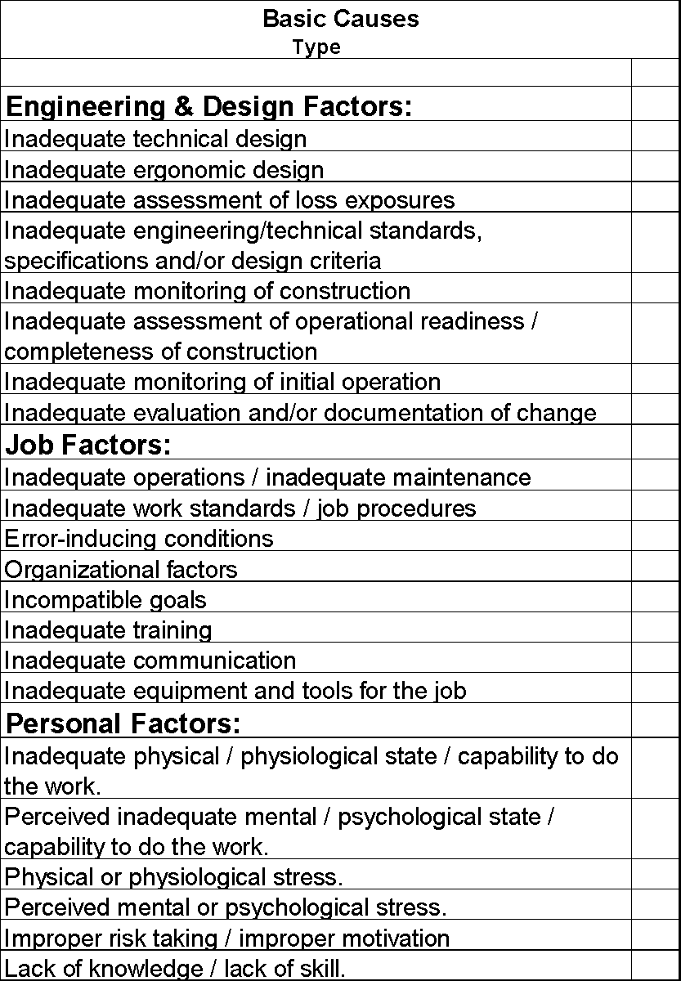
The Cause and Effect Model:
Middle:
This list is not all-inclusive. Sub-sub-categories of causes along similar lines can be added! For example:
E&DF: Inadequate assessment of hazards/risk
E&DF: inadequate monitoring during initial construction/assembly/fabrication
E&DF: inadequate management of change
JF: incompatible goals within the organization
If you cannot find a sub-category that is a direct match, it is acceptable to create another unique sub-sub-category.
Chapter 4.2: C&E Model & Chapter 4.3: RCA of an Incident
‹#›
Notes:
‹#›
C&E helps you be more specific in terms of losses and causes

Slide 10
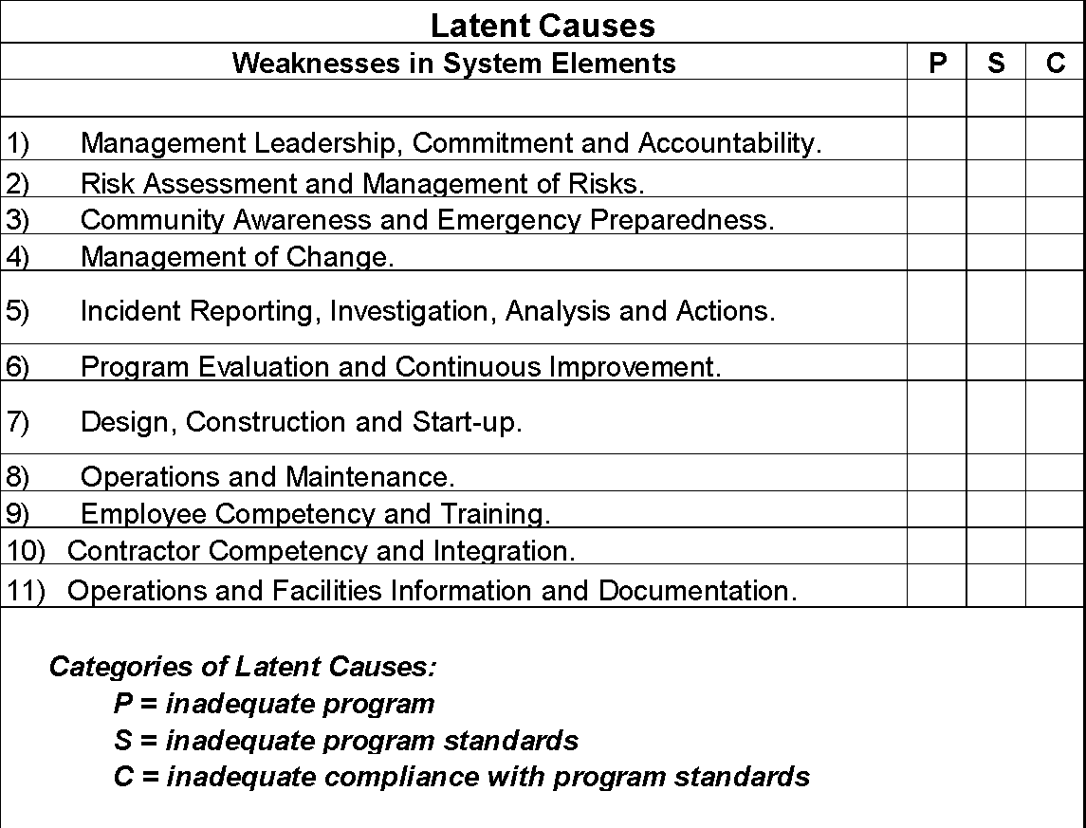
The Cause and Effect Model:
Right side:
A Risk Management System Element is NOT a latent cause.
A weakness in a RME IS a latent cause.
Chapter 4.2: C&E Model & Chapter 4.3: RCA of an Incident
‹#›
Notes:
‹#›
C&E helps you be more specific in terms of losses and causes

Slide 11
Categories of Causes:
Nature of the different categories of causes:
Immediate Causes – two sub-categories:
Sub-standard Conditions (SCs)
Sub-standard Practices (SPs)
Other terms used: Technical Factors or Actions
Sub-standard = unacceptable, incorrect, improper, inadequate, at-risk
Basic Causes – three sub-categories:
Engineering & Design Factors
Job Factors
Personal Factors
Latter two are sometimes collectively referred to Human Factors
Latent Causes:
Directly associated to failures or weaknesses in the Risk Management System and its elements.
Important! Latent Causes ARE NOT the elements of the Risk Management System
Chapter 4.2: C&E Model & Chapter 4.3: RCA of an Incident
‹#›
Notes:
‹#›

Slide 12
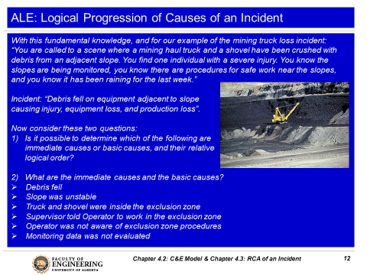
The Intent of the Active Learning Exercise:
The intent of this exercise is
NOT to inform you or test you
on the causes of this LI!
The intent of this exercise is to:
Select your responses in Mentimeter and discuss some of them in terms of “jumping to conclusions”, “facts”, “logic leaps”, “combination of causes”, etc.
Demonstrate that the causation of a loss incident must be explained in rational and sequentially logical terms in order to make sense and be of value in determining the latent causes of a loss incident.
Chapter 4.2: C&E Model & Chapter 4.3: RCA of an Incident
‹#›
Notes:
‹#›

Slide 13
Logical Progression of Causes of an Incident:
Incident Description: “The slope of an open quarry
slid down, debris fell on equipment adjacent to slope
causing injury, equipment loss, and production loss.”
Causes:
  Debris fell from the side
  Slope was unstable
  Truck and shovel were inside the exclusion zone
  Supervisor told Operator to work in the exclusion zone
  Operator was not aware of exclusion zone procedures
  Monitoring data was not evaluated
Some points:
  Difficult to decide – immediate or basic!
  Not quite logical … something is missing!
  “AND” and “OR” gates will help structure the logic.
To make sense, the loss incident and its sequence of events are best analysed using the Root Cause Analysis work process and C&E Model!
Chapter 4.2: C&E Model & Chapter 4.3: RCA of an Incident
‹#›
Notes:
‹#›

Slide 14
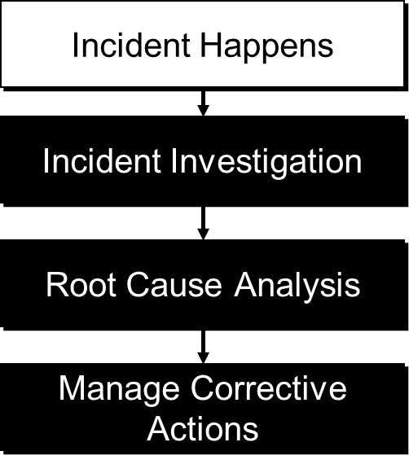
Root Cause Analysis Work Process:
Collect the facts … complete as much of the Incident
Investigation WP before moving on to the RCA WP!
Absolutely necessary that facts of the incident are known
especially the sequence of events leading up to the incident.
Time and effort can be saved by avoiding debate driven by
lack of information, or lack of consensus on plausible events.
Apply the RCA WP to logically breakdown the loss
incident to identify the causes of an incident, including
immediate causes, and
basic causes, and
latent causes;
In other words, to construct the Root Cause Analysis Chart!
The RCA Team identifies actual causes as well as possible, probable, plausible, or conceivable causes.
Chapter 4.2: C&E Model & Chapter 4.3: RCA of an Incident
‹#›
Notes:
‹#›

Slide 15
Root Cause Analysis Work Process:
Purpose, Starting Point, and Outcome:
The RCA WP is intended to drill down to the latent causes.
  Once latent causes (RMS element weaknesses) are identified, needed improvements & recommendations become evident.
The starting point is the Incident Description.
  The RCA reliably describes the sequence of events leading up to the incident – in detail.
The product or outcome of the RCA Work Process is an RCA Chart.
Some benefits:
Focuses on one specific cause at a time.
Identifies all causes through brainstorm thinking, supported by evidence in actual loss incidents under investigation
Provides a visual representation of the incident in a clear and logical manner.
Chapter 4.2: C&E Model & Chapter 4.3: RCA of an Incident
‹#›
Notes:
‹#›

Slide 16
Root Cause Analysis Work Process:
How to Construct a Root Cause Analysis – the Steps:
Define and state the Incident Description.
Ask what caused this i.e. “Ask why?”
For each subsequent cause, ask the same question, “why?”
Immediate causes at the initial levels, followed by basic causes.
Use “AND” and “OR” gates to logically connect causes.
Continue to drill down to ultimately discover the latent causes.
Build sound logic in your RCA Chart - avoid “logic leaps”.
Use the narrative technique: “This … was caused by this … . This … was caused by this … .”
Chapter 4.2: C&E Model & Chapter 4.3: RCA of an Incident
‹#›
Notes:
‹#›

Slide 17
Nomenclature and Symbols for Root Cause Analysis:
How practices (activities, actions, behaviours) and conditions (hazards) are viewed in order to cause an event:
“AND” Gate:
One possibility is a combination of practices must happen
i.e. Practice A AND Practice B
Another possibility is a combination of conditions must be present
i.e. Condition A AND Condition B
And another possibility is a combination of practices must happen and conditions must be present i.e. Practice A AND Condition B.
“OR” Gate:
One of several practice must happen
i.e. Practice A OR Practice B
One of several conditions must be present
i.e. Condition A OR Condition B
One of several practices must happen or conditions must be present i.e. Practice A OR Condition B.
Event
AND
A
B
Event
OR
A
B
Chapter 4.2: C&E Model & Chapter 4.3: RCA of an Incident
‹#›
Notes:
‹#›

Slide 18
Example: “AND” and “OR” Gates
With this knowledge, and for our example of the mining incident:
“You are called to a scene where a mining haul truck and a shovel have been crushed with debris from an adjacent slope. You find one individual with a serious injury. You know the slopes are being monitored, you know there are procedures for safe work near the slopes, you know it had been raining for the last week.”
Think about where the ‘and’ and ‘or’ gates would apply in this case.
Let’s begin with an RCA Chart of this loss incident:
Chapter 4.2: C&E Model & Chapter 4.3: RCA of an Incident
‹#›
Notes:
‹#›

Slide 19
Incident & Losses
Debris fell on equipment, injuring one worker & damaging equipment
Debris Fell
Equipment & Operator Were In Exclusion Zone
Unstable slope
Rain
Didn’t follow exclusion zone procedures
No effective warning
Poor slope construction
Poor slope design
Monitoring data not evaluated
No effective communication
Operator not aware of exclusion zone procedures
Supervisor told Op to be inside the exclusion zone
  We begin to construct our RCA Chart by starting with an INCIDENT DESCRIPTION AND asking
  “what caused debris to fall on equipment, etc.?”
  Note the use of the AND gate here.
Chapter 4.2: C&E Model & Chapter 4.3: RCA of an Incident
‹#›

Slide 20
Incident & Losses
Debris fell on equipment, injuring one worker & damaging equipment
Debris Fell
Equipment & Operator Were In Exclusion Zone
Unstable slope
Rain
Didn’t follow exclusion zone procedures
No effective warning
Poor slope construction
Poor slope design
Monitoring data not evaluated
No effective communication
Operator not aware of exclusion zone procedures
Supervisor told Op to be inside the exclusion zone
  We continue to construct our RCA Chart by asking “why?” or “what caused…?” Note the use of AND and OR gates to make the logical connections.
Chapter 4.2: C&E Model & Chapter 4.3: RCA of an Incident
‹#›

Slide 21
Aids For Finding and Classifying Causes:
Use the Detailed Cause and Effect Model:
Recall your Cause and Effect Model … a detailed look:
Immediate Causes in two categories:
Substandard practices and sub-groups
Substandard conditions and sub-groups
Basic Causes in three categories:
Engineering & Design Factors
Job Factors and sub-groups
Personal Factors and sub-groups
Intermediate cause – a cause statement that cannot be readily categorized as any one of IC, BC, or LC.
Latent Causes – will be discussed in much more depth in the next topic.
Chapter 4.2: C&E Model & Chapter 4.3: RCA of an Incident
‹#›
Notes:
‹#›

Slide 22
Immediate Cause Categories and Sub-categories:
Substandard Practices (examples) | Substandard Conditions (examples)
Operating equipment without authority Failure to follow established procedures Making safety devices inoperable Failing to use personal protective equipment Servicing equipment in operation Horseplay Under influence of alcohol, drugs | Inadequate or improper protective equipment Defective tools, equipment or materials Inadequate warning systems Fire and explosion hazards (hidden) Poor housekeeping; disorderly workplace Hazardous environmental conditions Noise exposures Inadequate ventilation
Chapter 4.2: C&E Model & Chapter 4.3: RCA of an Incident
‹#›
Notes:
‹#›

Slide 23
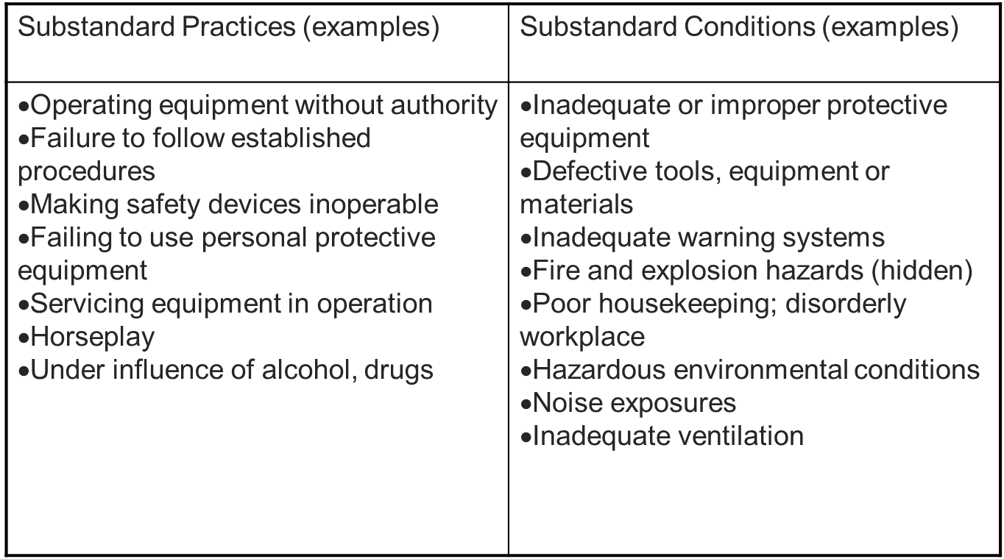
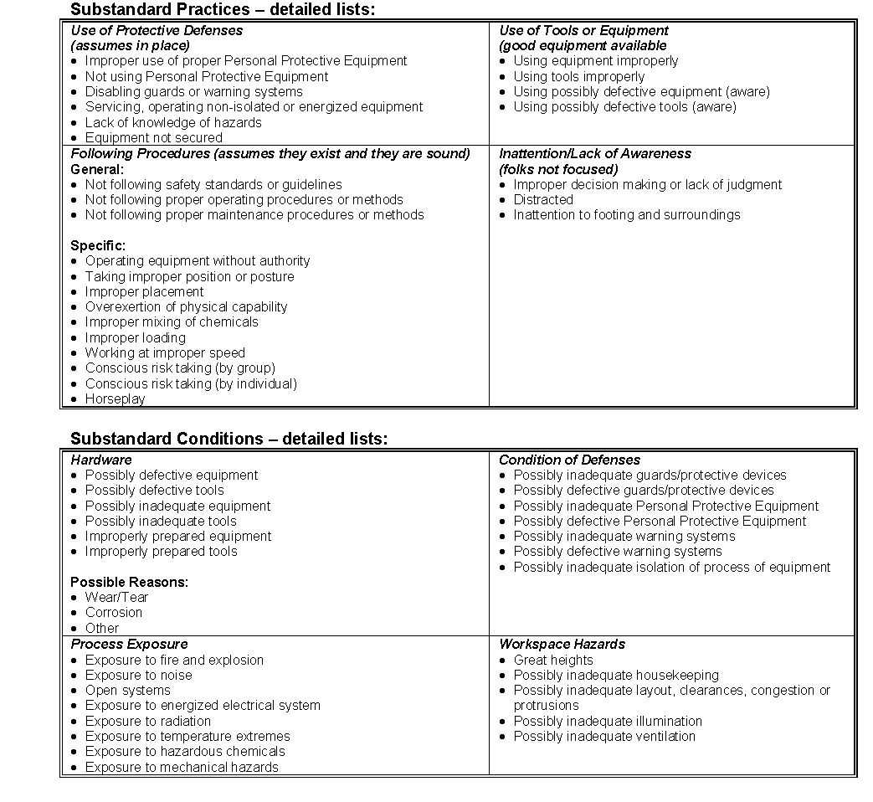
Immediate Cause Categories & Sub-categories Detailed Lists:
Chapter 4.2: C&E Model & Chapter 4.3: RCA of an Incident
‹#›
Notes:
‹#›

Slide 24
Incident Description
Debris fell on equipment, injuring one worker & damaging equipment
Debris Fell
Equipment & Operator Were In Exclusion Zone
Unstable slope
Rain
Didn’t follow exclusion zone procedures
No effective warning
Poor slope construction
Poor slope design
Monitoring data not evaluated
No effective communication
Operator not aware of exclusion zone procedures
Supervisor told Op to be inside the exclusion zone
Can you identify three immediate causes?
Chapter 4.2: C&E Model & Chapter 4.3: RCA of an Incident
‹#›

Slide 25
Incident Description
Debris fell on equipment, injuring one worker & damaging equipment
Immediate Causes
Debris Fell
Equipment & Operator Were In Exclusion Zone
Unstable slope
Rain
Didn’t follow exclusion zone procedures
No effective warning
Poor slope construction
Poor slope design
Monitoring data not evaluated
No effective communication
Operator not aware of exclusion zone procedures
Supervisor told Op to be inside the exclusion zone
How could these three immediate causes be categorized?
Sub-standard condition?
Sub-standard work practice?
Chapter 4.2: C&E Model & Chapter 4.3: RCA of an Incident
‹#›

Slide 26
Incident Description
Debris fell on equipment, injuring one worker & damaging equipment
Immediate Causes
Debris Fell
Equipment & Operator Were In Exclusion Zone
Unstable slope
Rain
Didn’t follow exclusion zone procedures
No effective warning
Poor slope construction
Poor slope design
Monitoring data not evaluated
No effective communication
Operator not aware of exclusion zone procedures
Supervisor told Op to be inside the exclusion zone
Sub-standard condition
Sub-standard work practice
Sub-standard work practice
Chapter 4.2: C&E Model & Chapter 4.3: RCA of an Incident
‹#›

Slide 27
Incident Description
Debris fell on equipment, injuring one worker & damaging equipment
This is an “event” in the incident.
Immediate Causes
Debris Fell
Equipment & Operator Were In Exclusion Zone
Intermediate Causes
Unstable slope
Rain
Didn’t follow exclusion zone procedures
No effective warning
Basic Causes
Poor slope construction
Poor slope design
Monitoring data not evaluated
No effective communication
Operator not aware of exclusion zone procedures
Supervisor told Op to be inside the exclusion zone
“1st immediate cause” in the root pathway
“2nd immediate cause” in the root pathway
“1st immediate cause” in the root pathway
Sub-standard condition
Sub-standard work practice
Sub-standard work practice
Chapter 4.2: C&E Model & Chapter 4.3: RCA of an Incident
‹#›

Slide 28
Example: Immediate Causes - Categories and Sub-categories
The category and sub-category for each of these three Immediate Causes:
Unstable slope
Equipment & operator in exclusion zone
Operator didn’t follow exclusion zone procedures
(See NOTES below.)
Substandard Practices (examples) | Substandard Conditions (examples)
Operating equipment without authority Failure to follow established procedures Making safety devices inoperable Failing to use personal protective equipment Servicing equipment in operation Horseplay Under influence of alcohol, drugs | Inadequate or improper protective equipment Defective tools, equipment or materials Inadequate warning systems Fire and explosion hazards (hidden) Poor housekeeping; disorderly workplace Hazardous environmental conditions Noise exposures Inadequate ventilation
b) c) Failure to follow established procedures (Admin. Controls: safety rules, policies, etc.)
a) Hazardous environmental conditions
Chapter 4.2: C&E Model & Chapter 4.3: RCA of an Incident
‹#›
Notes:
‹#›
You may have noticed on the RCA Chart that some of these were aligned with “Immediate Cause” and some with “Intermediate Cause”. An intermediate cause can link an immediate cause to a basic cause but if it can clearly be categorized and sub-categorized as an “Immediate Cause”, then that is quite acceptable; and it is quite acceptable to have an immediate cause caused by another immediate cause.

Slide 29
Basic Causes and Categories:
Engineering & Design Factors: (can apply to structures, equipment, tools, products, raw materials, i.e. any engineered system) | Job Factors: | Personal Factors:
inadequate technical design inadequate ergonomic design inadequate assessment of loss exposures inadequate standards, specifications and/or design criteria inadequate monitoring of construction inadequate assessment of operational readiness inadequate monitoring of initial operation inadequate evaluation and/or documentation of change inadequate inherently safe design | Inadequate maintenance Inadequate job procedures Error-inducing conditions Organizational factors Incompatible goals Inadequate training Inadequate communication | Inadequate physical / physiological state / capability to do the work. Perceived inadequate mental / psychological state / capability to do the work. Physical or physiological stress. Perceived mental or psychological stress. Improper risk taking / improper motivation Lack of knowledge / lack of skill.
Chapter 4.2: C&E Model & Chapter 4.3: RCA of an Incident
‹#›
Notes:
‹#›

Slide 30
Basic Causes (Engineering / Job / Personal Factors):
How do you identify basic causes?
Difficult to identify; often not evident until after an incident has been investigated and analyzed.
Two Questions to ask to get the Basic Causes:
Why did that Substandard Condition exist?
Why did that Substandard Practice occur?
Chapter 4.2: C&E Model & Chapter 4.3: RCA of an Incident
‹#›
Notes:
‹#›

Slide 31
Incident Description
Debris fell on equipment, injuring one worker & damaging equipment
Immediate Causes
Debris Fell
Equipment & Operator Were In Exclusion Zone
Intermediate Causes
Unstable slope
Rain
Didn’t follow exclusion zone procedures
No effective warning
Basic Causes
Poor slope construction
Poor slope design
Monitoring data not evaluated
No effective communication
Operator not aware of exclusion zone procedures
Supervisor told Op to be inside the exclusion zone
How could our basic causes be categorized?
Job factors, Personal Factors, Engineering & Design Factors?
Chapter 4.2: C&E Model & Chapter 4.3: RCA of an Incident
‹#›

Slide 32

Example: Basic Causes and Categories
The basic cause categories for the following:
Poor slope design
Operator not aware of exclusion zone procedures
Supervisor told Operator to be in exclusion zone
Engineering & Design Factors: (can apply to structures, equipment, tools, i.e. any engineered system) | Job Factors: | Personal Factors:
inadequate technical design inadequate ergonomic design inadequate assessment of loss exposures inadequate standards, specifications and/or design criteria inadequate monitoring of construction inadequate assessment of operational readiness inadequate monitoring of initial operation inadequate evaluation and/or documentation of change inadequate inherently safe design | Inadequate maintenance Inadequate job procedures Error-inducing conditions Organizational factors Incompatible goals Inadequate training Inadequate communication | Inadequate physical / physiological state / capability to do the work. Perceived inadequate mental / psychological state / capability to do the work. Physical or physiological stress. Perceived mental or psychological stress. Improper risk taking / improper motivation Lack of knowledge / lack of skill.
a) Inadequate technical design
c) Improper motivation / improper risk taking
Chapter 4.2: C&E Model & Chapter 4.3: RCA of an Incident
‹#›
Notes:
‹#›

Slide 33
Key Points:
The Intent of The Tables of Detailed Lists:
Tables help guide the user in categorizing the incident details including the immediate and basic causes.
FYI: These tables are not exhaustive and all-inclusive; there may be other sub-sub-categories that can be created.
Categorization of Causes:
When reporting the categories of a cause, it is important to recognize the major category, the sub-category, and the sub-sub-category
e.g. basic cause, job factor, inadequate training.
Latent causes will be discussed in detail in the next topic.
Chapter 4.2: C&E Model & Chapter 4.3: RCA of an Incident
‹#›
Notes:
‹#›

Slide 34
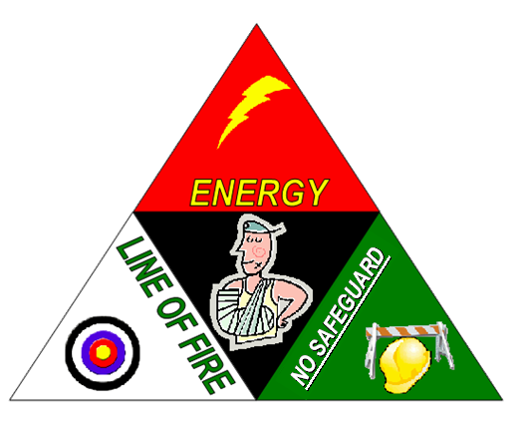
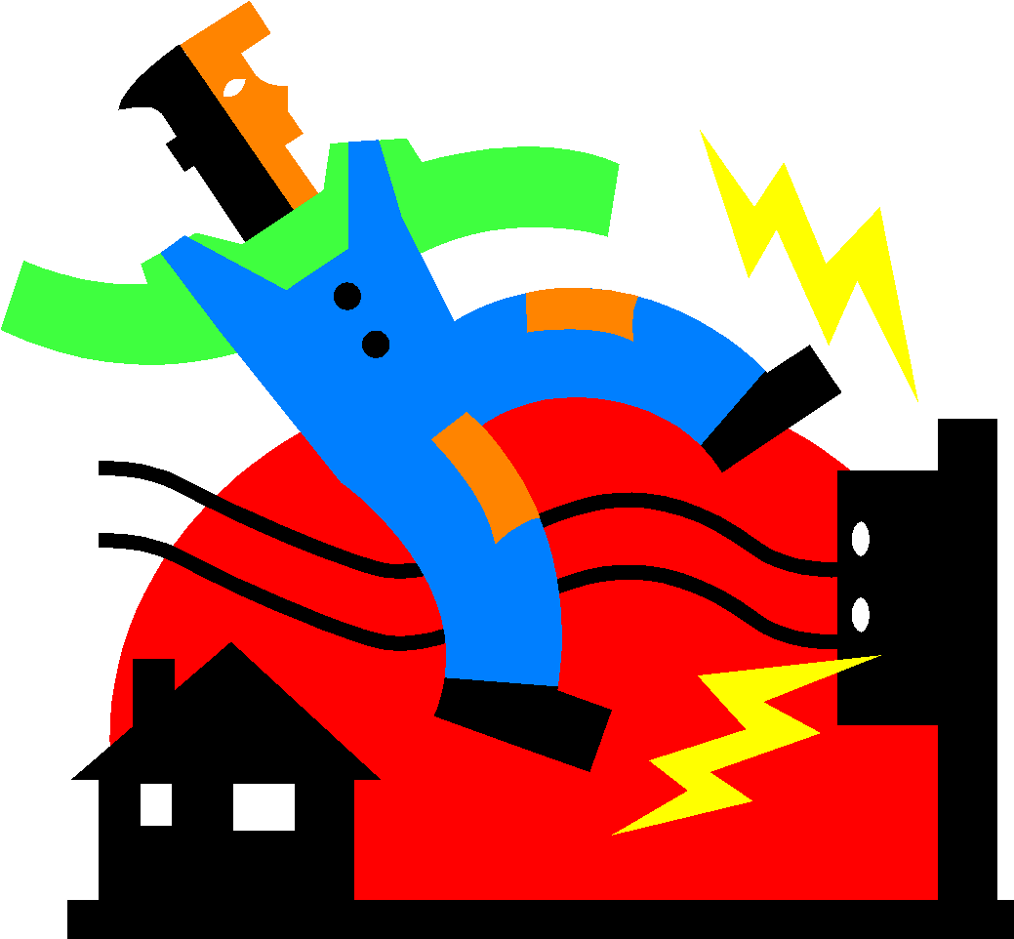
“Ask Why?” and The Discovery Approach
After you have written a detailed incident description, summarise it.
“Ask Why?”, as demonstrated in the previous slides, and the
Discovery Approach are suitable.
See topic #11 Chapter 2.3: Hazards and Hazard Identification to review The Discovery Approach
The Discovery Approach is much more methodical:
What is the Energy Source?
What is the Triggering Event?
What is in the Line-of-Fire?
What is the lack of or No Safeguard?
Chapter 4.2: C&E Model & Chapter 4.3: RCA of an Incident
‹#›
Notes:
‹#›

Slide 35
Example: Apply the Discovery Approach in an RCA:
What are the responses to the questions when applying the Discovery Approach?
Discovery Approach:
  Energy Source?
  Triggering Event?
  Line-of-Fire?
  No Safeguard?
The slope slid, debris fell on equipment, injuring one worker & damaging equipment
?
?
?
?
Energy Source:
?
Triggering Event:
?
Line-of-Fire:
?
No Safeguard:
?
Chapter 4.2: C&E Model & Chapter 4.3: RCA of an Incident
‹#›
Notes:
‹#›

Slide 36
Example: Apply the Discovery Approach in an RCA:
The example shown here is but one of many ways to start constructing the RCA chart based on the summarized incident description. As you progress through the RCA chart by “asking why”, the logical order of these causes may be changed in order to make each of the developing roots in the chart flow logically and smoothly.
The slope slid, debris fell on equipment, injuring one worker & damaging equipment
Debris fell
Slope was unstable
Equipment and People in the area
Exclusion zone not marked
Energy Source:
gravity
Triggering Event:
instability
Line-of-Fire:
people & equipment
No Safeguard:
No physical barrier
Chapter 4.2: C&E Model & Chapter 4.3: RCA of an Incident
‹#›
Notes:
‹#›

Slide 37
Summary and Key Lessons:
Summary:
This topic explains the purpose and application of the Cause & Effect Model, and the fundamental constructs of a Root Cause Analysis.
The Detailed Cause & Effect Model is introduced as a means to understand and explain the various different categories of causes.
The RCA Work Process is introduced as a means to logically discover and arrange all of the causes leading to an incident.
  The RCA WP starts with the Incident Description, and proceeds through immediate causes, basic causes, and latent causes.
  “Ask why?” can be applied throughout the RCA
  The Discovery Approach can be applied to start the RCA.
Key Lessons:
The RCA work process is used to create an RCA Chart.
After the chart has been created, the Cause & Effect Model is used to:
Categorize the causes in an RCA Chart,
Check the thoroughness and quality of an RCA Chart, and
Revise the RCA Chart to make improvements on it.
Chapter 4.2: C&E Model & Chapter 4.3: RCA of an Incident
‹#›
Notes:
‹#›

